Slide 1

Toolkit Doc29 Steeo Camera
March 1, 2011

Slide 2
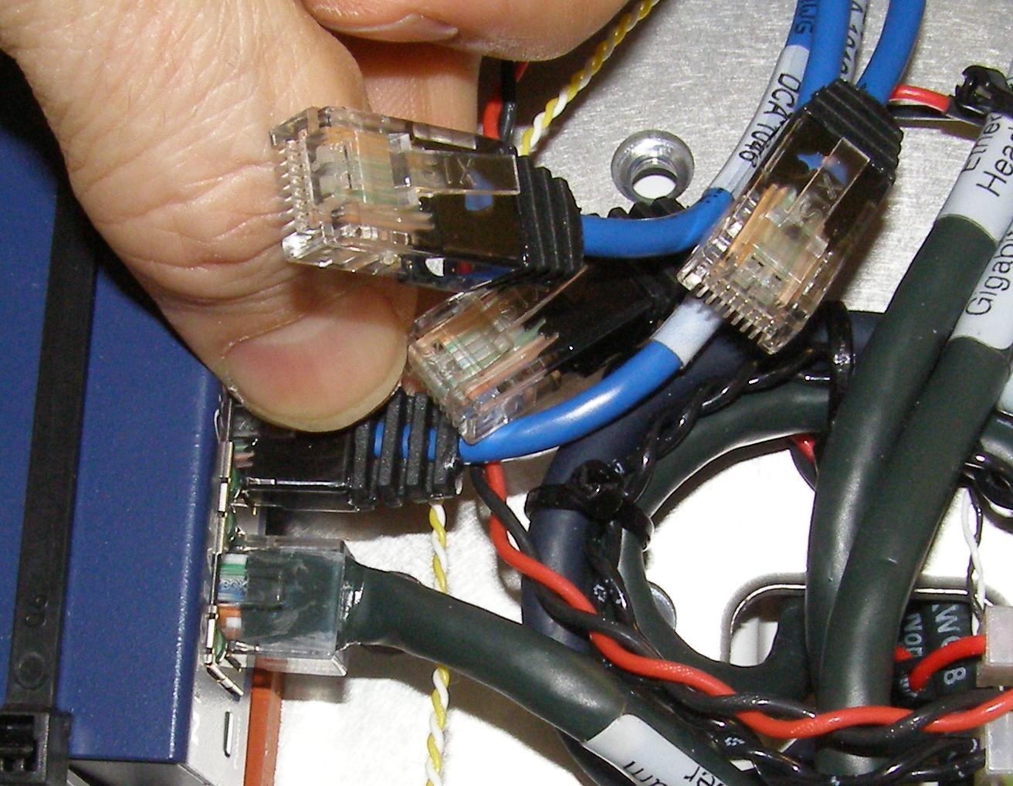
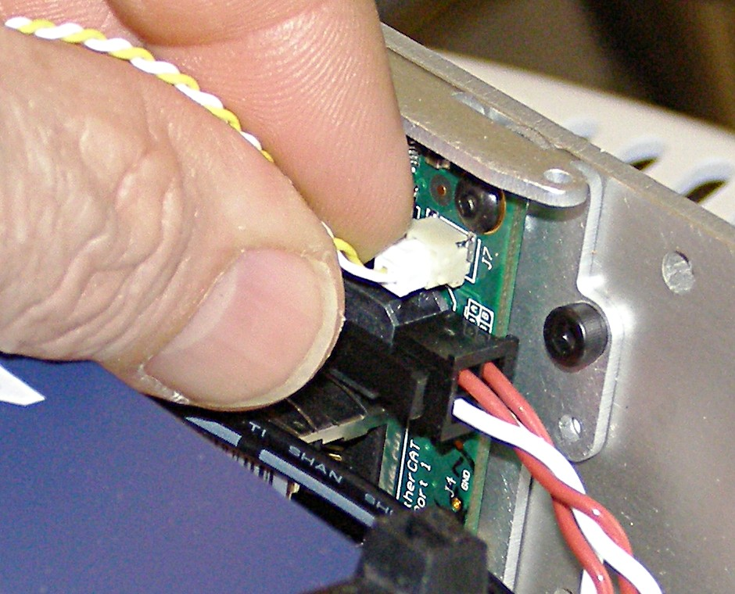
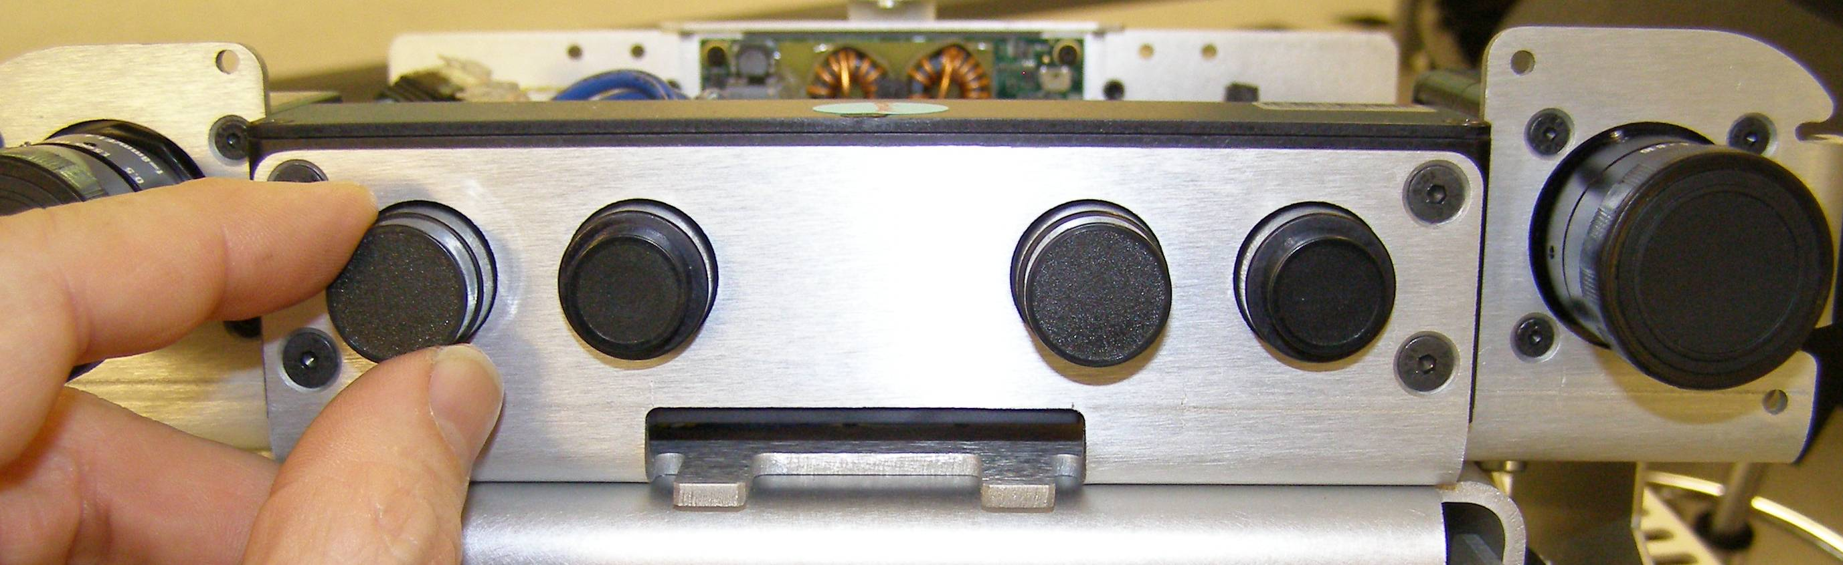
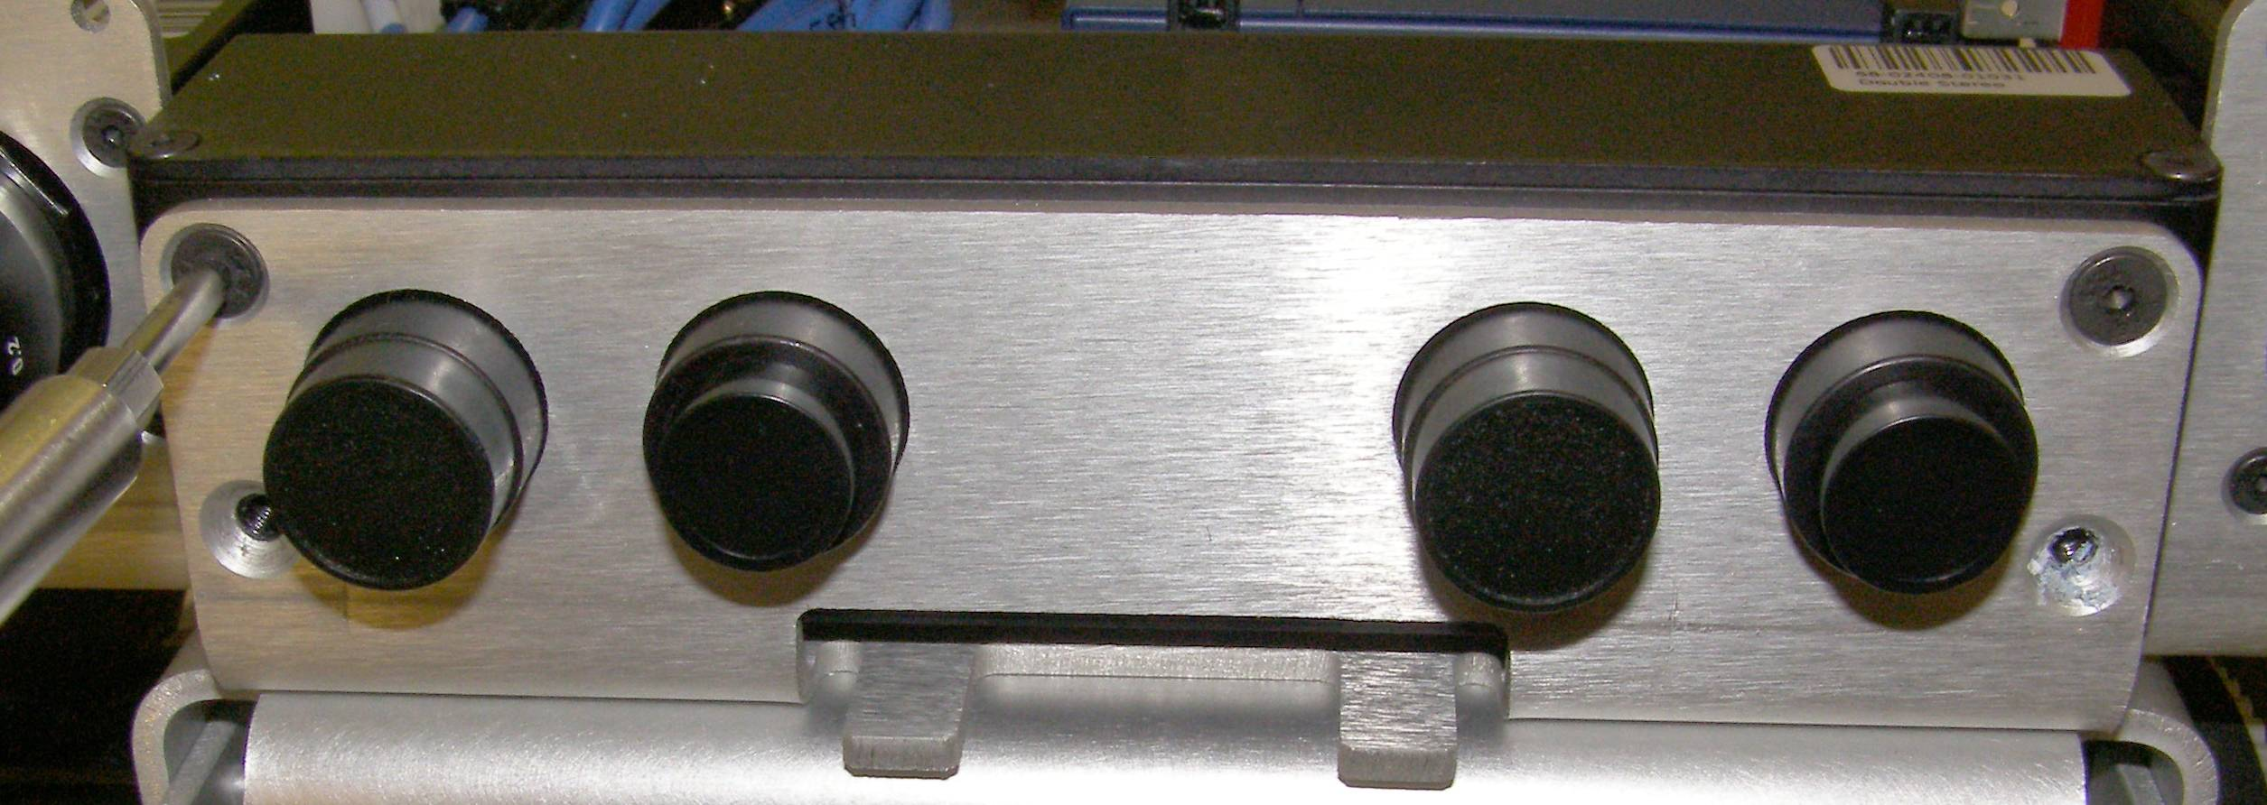
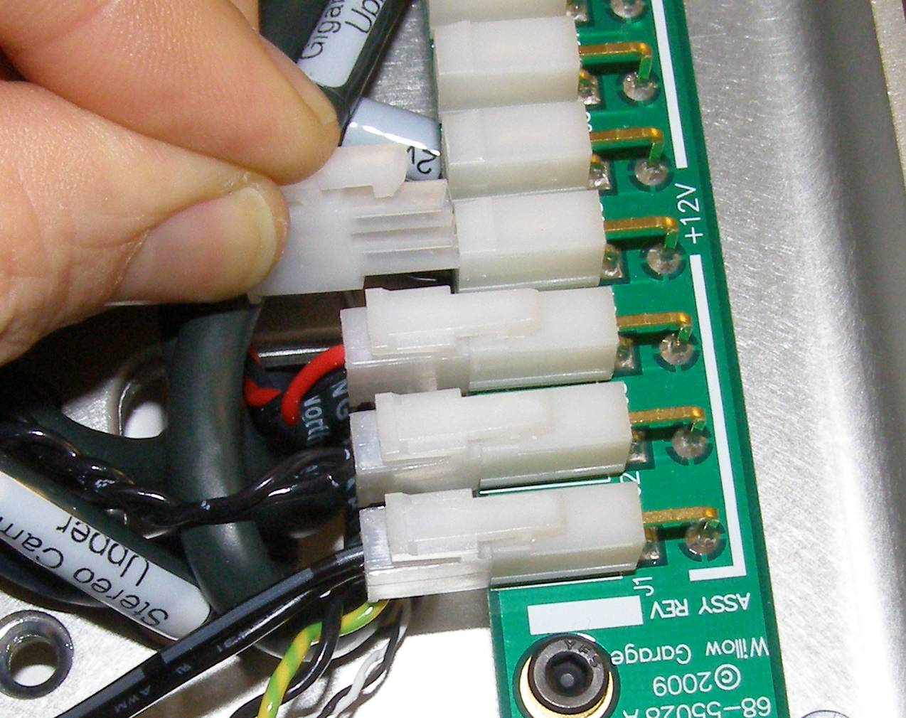
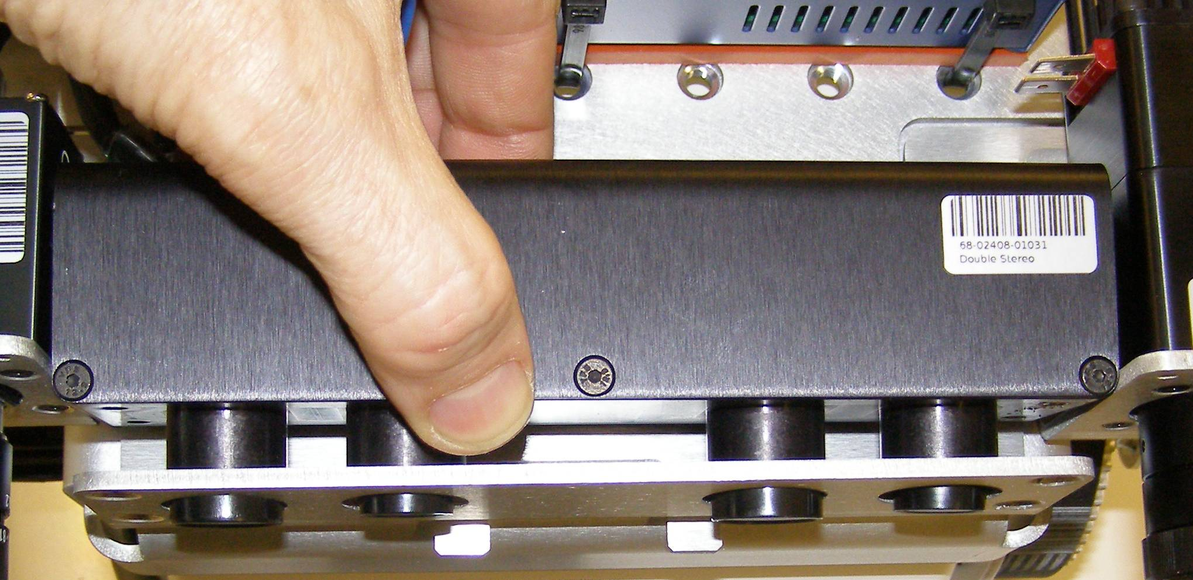
Stereo Camera Remove
Refer to the PR2 Overview document for additional information.
Make sure the Robot is turned off and unplugged from wall power.
Remove the Head Pan Tilt Left. (Doc11)
Remove the Head Pan Tilt Right. (Doc11)
Remove the Head Hatch. (Doc12)
Remove the Head Bezel Rear. (Doc12)
Remove the Head Bezel Front. (Doc12)
Remove the Head Bonnet. (Doc12)
Pushing down on the latch, remove the Camera trigger cable from the MCB. (Fig. 1)
Disconnect the Power connector. (Fig. 2)
Unplug the 4 Ethercat cables. (Fig. 3)
Make sure the lens covers are in place before removing the Stereo Camera. (Fig. 4)
Using the 2.5mm bit together with the T-handle driver, remove the 4 mounting screws. (Fig. 5)
Lifting the back of the Stereo camera, remove the camera from the rear being careful not to damage the lens assembly. (Fig. 6)
Fig 3
Fig 1
Fig 4
Fig 5
Fig 2
Fig 6

Slide 3
Stereo Camera Install
Reverse the removal procedure.
Carefully feed the camera lenses through the mounting holes.
Using Loctite 248, install the 4 screws and torque to 1.36Nm using the Large torque driver.
Plug the Power connector back into the +12v Breakout board.
Plug the 4 Ethercat cables into the Hub.
Plug the Camera trigger cable back into the MCB.
Follow the installation procedures in Doc11 and Doc12 to reassemble the Head covers.

